Slide 1
One platform for how Otta works
Product demo, then ideas, copy and Phase 1 decisions | 16 October 2026
Notes:
Welcome. Today we'll walk through the website, the broker portal and the admin portal working together, look at three features added this week, then use the second half to agree what's next: ideas, the copy we still need, and what it takes to launch the website.

Slide 2
Today: 60 minutes
3 min
Why one platform
What Otta has now, in one sentence
28 min
Product walkthrough
A day in Otta's life, live
5 min
New this week
E-signatures, document uploads, analytics and SEO
10 min
What could we add
Vote on the ideas board
7 min
Copy still needed
Put a name against every item
7 min
Phase 1 decisions
Launch date, owners, sign-off
Notes:
Keep the walkthrough moving: about three minutes a stop. Hold questions about new features for the ideas section so we finish on decisions.

Slide 3
Three connected parts, one record
1
Website
2
Broker portal
3
Admin portal
Visitors find the right cover, read wordings, fact sheets and FAQs, ask Brad, and send enquiries.
Brokers apply online or send their client a link, sign and attach documents, bind, follow claims and see their book.
Every enquiry, application and bind lands live. The underwriting assistant reads applications against the guide.
6
12
47
31
4
4
products
online forms
rating regions mapped
FAQs
levels of broker access
training decks
Notes:
The website, the broker portal and the admin portal are one system. Every enquiry, application and bind lands in one place, and the underwriting starts before anyone opens the email.

Slide 4
The walkthrough
01
A visitor finds us, a broker applies, an underwriter decides, the broker binds, and the book reports itself.
Notes:
The walkthrough. A visitor finds us, a broker applies, an underwriter decides, the broker binds, and the book reports itself.

Slide 5
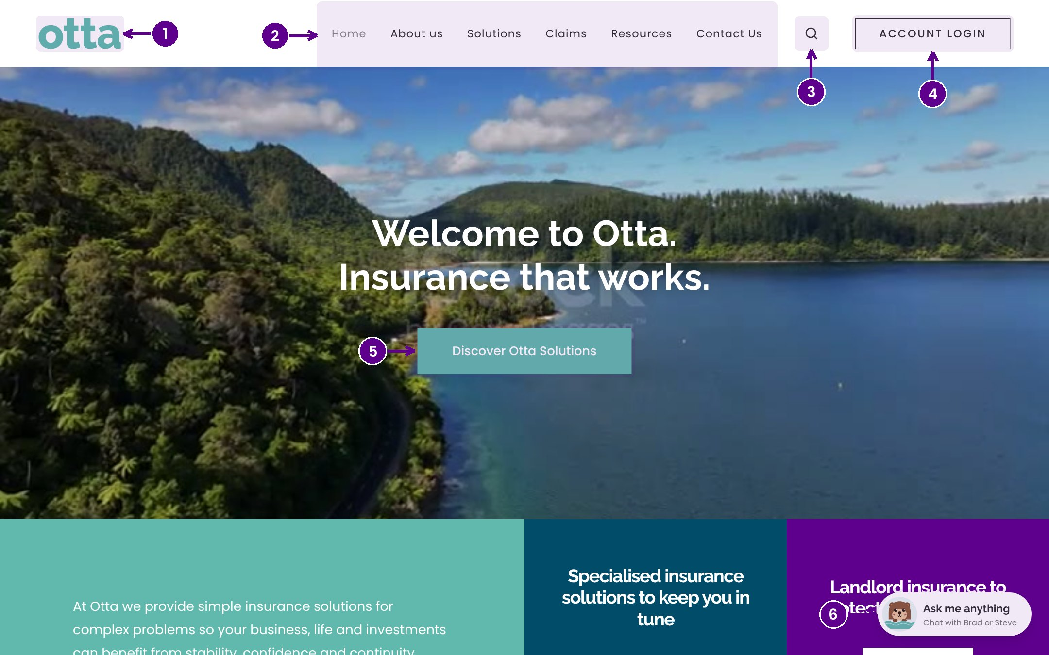
The website
WHAT YOU'LL SEE
Six products, each with Apply now, wordings and a fact sheet
Documents open in a new tab
Search goes straight to the right FAQ answer
WOW MOMENT
Search "airbnb" and land on the exact answer, already open.
Notes:
Show the home page, open Rental Property, open the social housing fact sheet in a new tab, then search for airbnb. Every word on the site lives in one place so the team can change copy without hunting through pages.

Slide 6
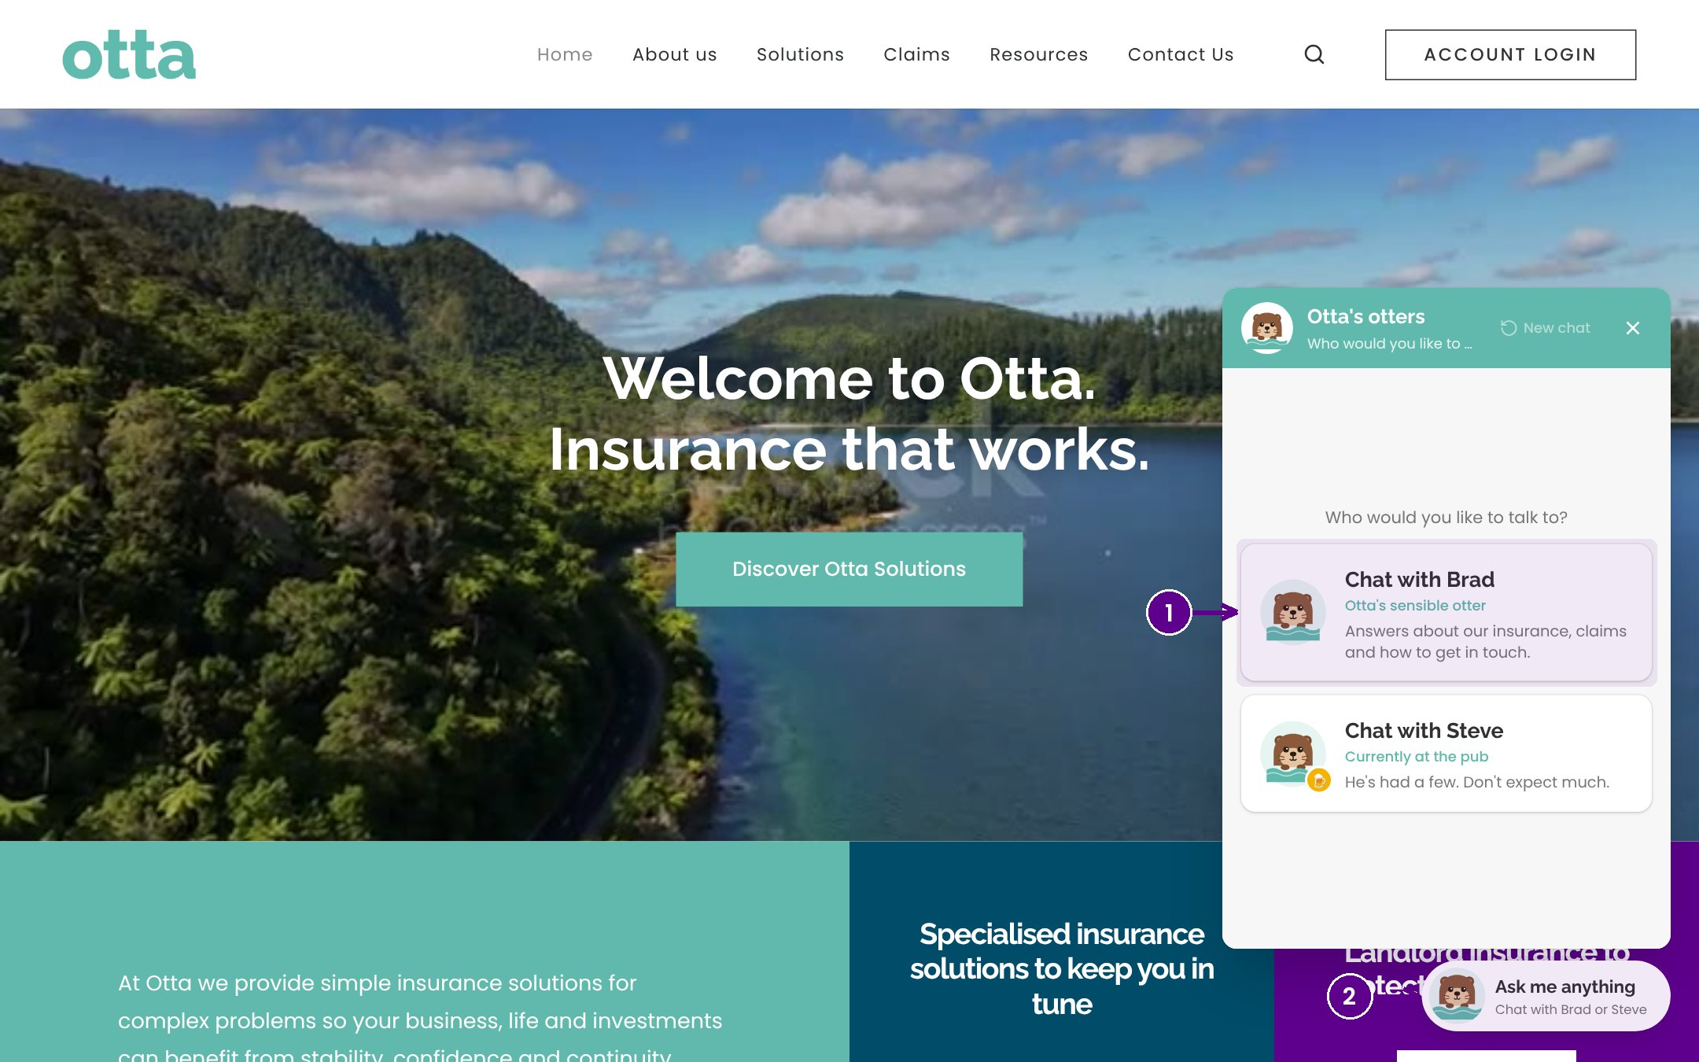
Brad, the website otter
WHAT YOU'LL SEE
Answers from Otta's own products, fact sheets and FAQs
General information only, with a disclaimer
Steve is the joke otter: keep him or not?
WOW MOMENT
A 24/7 assistant that already speaks in Otta's voice.
Notes:
Ask Brad: does rental property insurance cover meth contamination? Then let someone ask Steve anything. Whether Steve stays for launch is one of today's decisions.

Slide 7
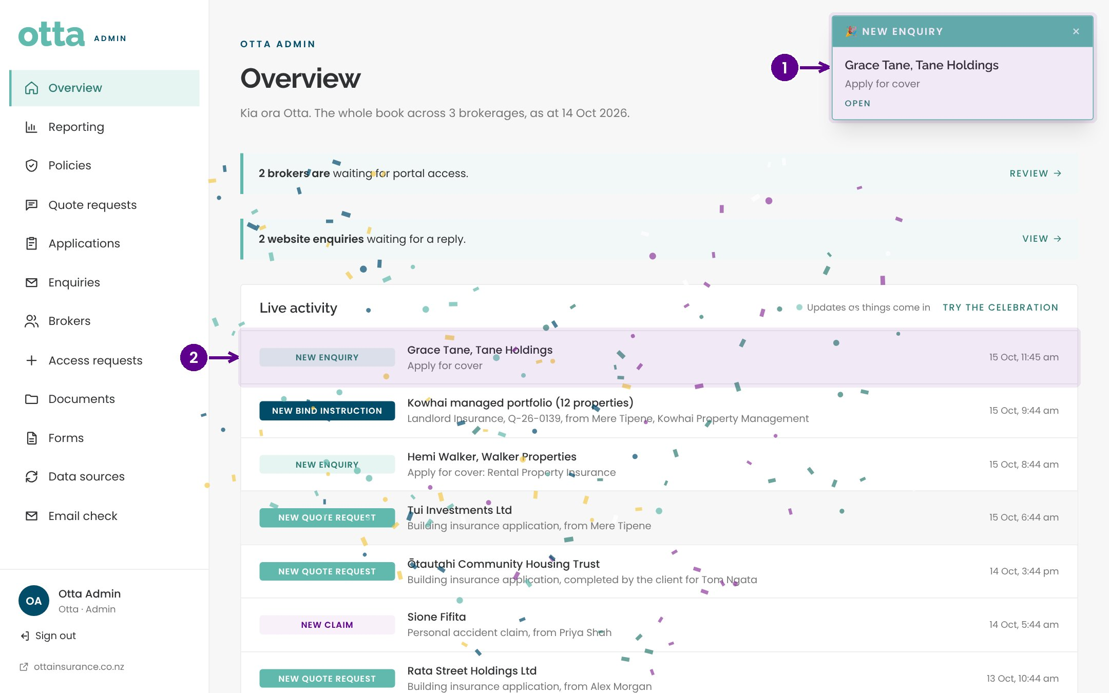
A live enquiry
WHAT YOU'LL SEE
Admin overview on the big screen
Send the contact form from a phone
Confetti, a card, and an email to the team
WOW MOMENT
Confetti on the big screen the moment the phone sends.
Notes:
This is the moment to pause. Every enquiry, quote request, claim and bind instruction now lands here live, not in someone's inbox. Mark handled shows who has replied.

Slide 8
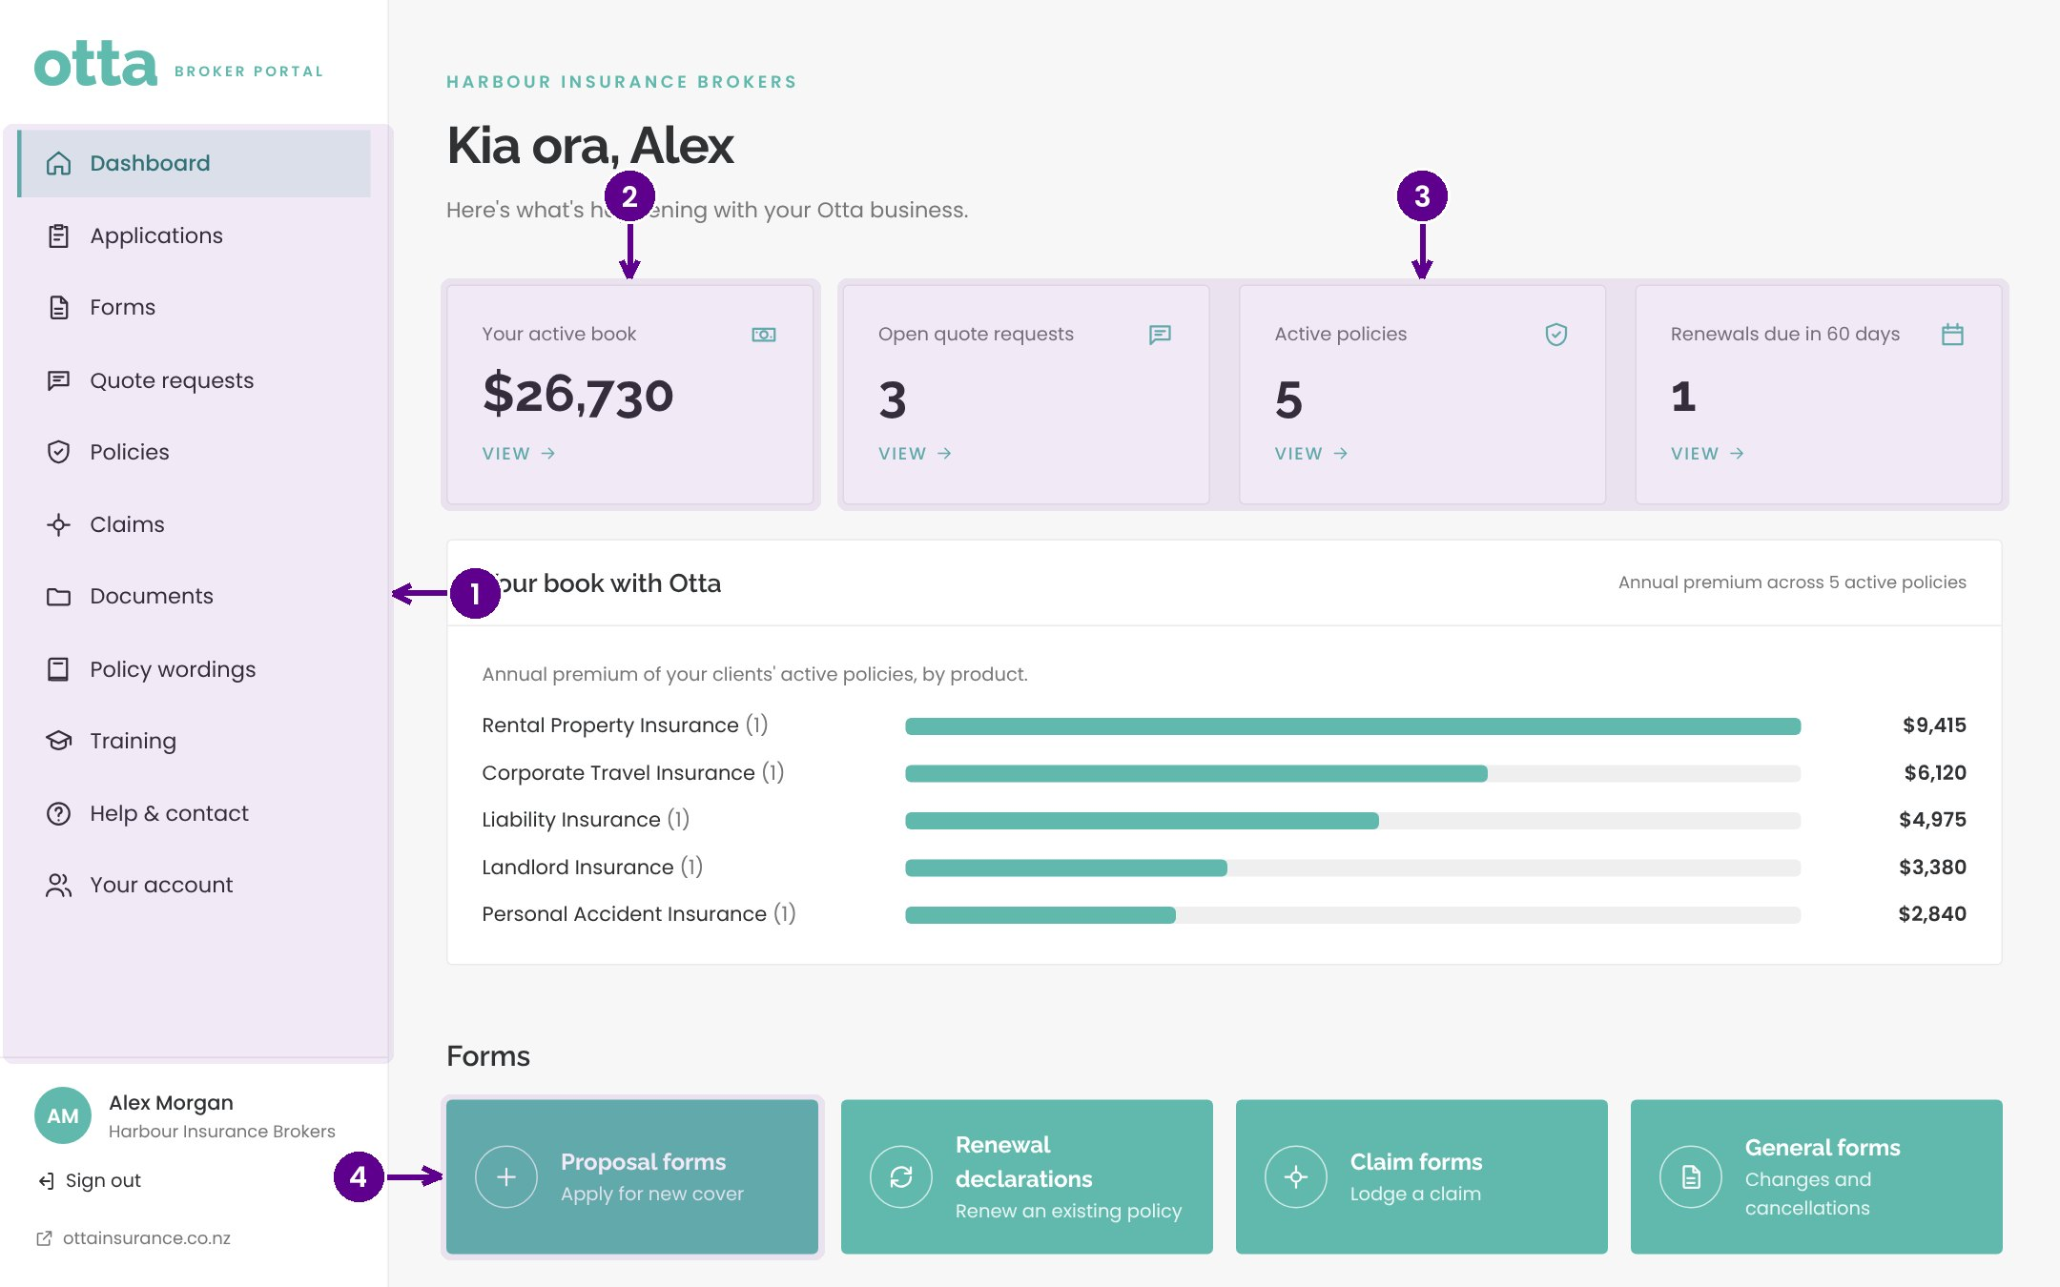
The broker portal
WHAT YOU'LL SEE
The broker's active book with Otta, by product
Forms grouped by product, with cover help
A secure link the broker sends their client themselves
WOW MOMENT
Brokers see their whole relationship with Otta on one screen.
Notes:
Sign in as Alex at Harbour Insurance Brokers. Otta never contacts a broker's clients: the broker owns that relationship and the portal respects it.

Slide 9
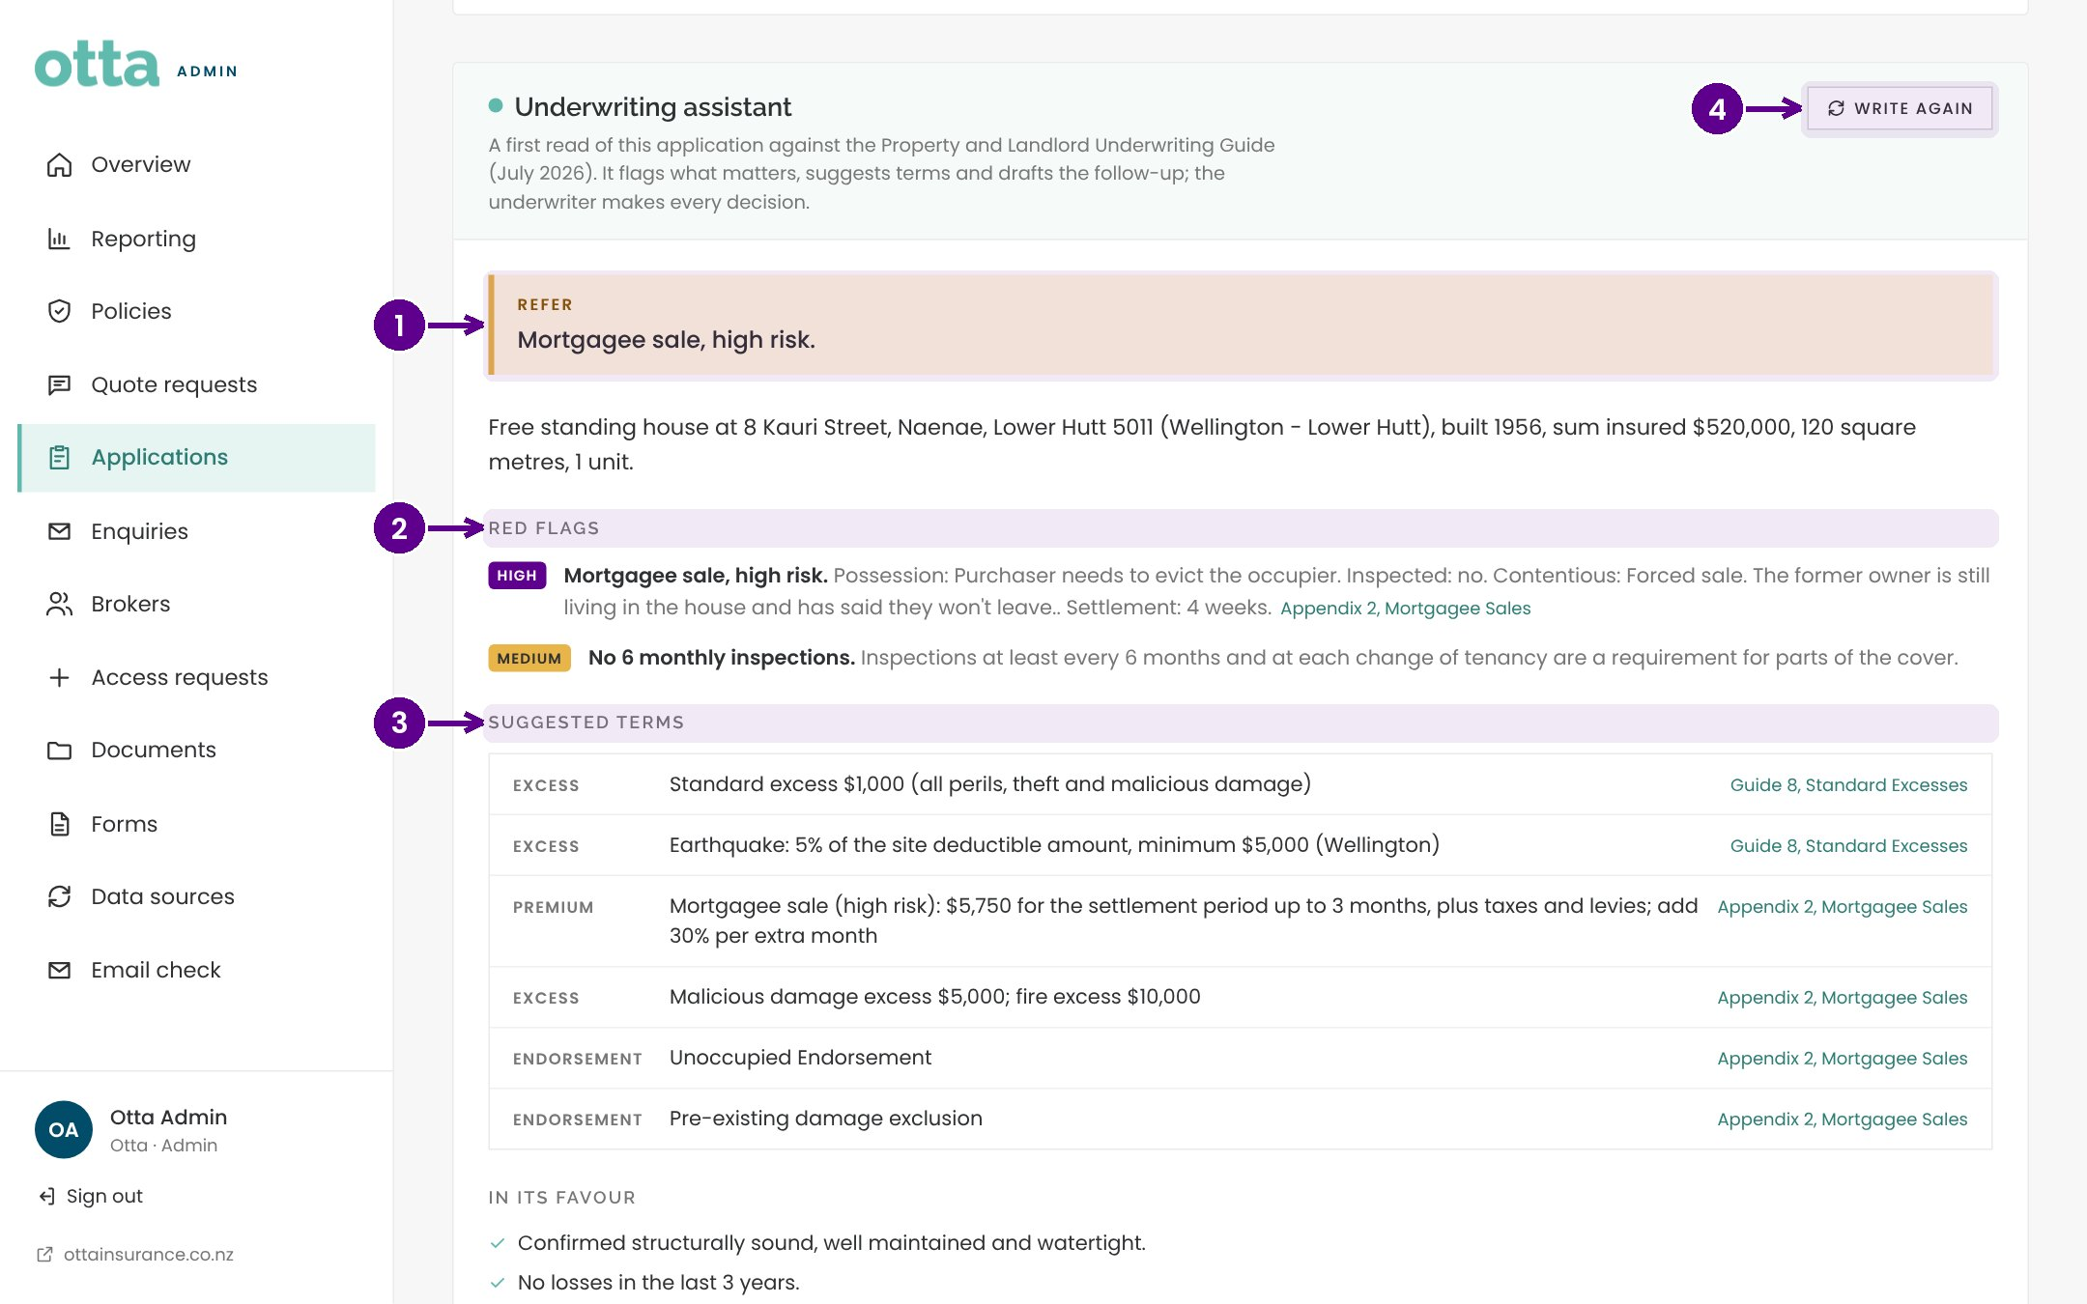
Application in, underwriting brief out
WHAT YOU'LL SEE
Submit a building application live
The assistant reads it against the underwriting guide
Red flags, suggested terms and a pre-filled V13 worksheet
WOW MOMENT
From Submit to a referral decision and pre-filled V13 in under a minute.
Notes:
The assistant gives a first read in seconds and cites the guide section for every suggestion. The underwriter makes every decision. No more rekeying into V13: copy, click the yellow cell, paste.

Slide 10
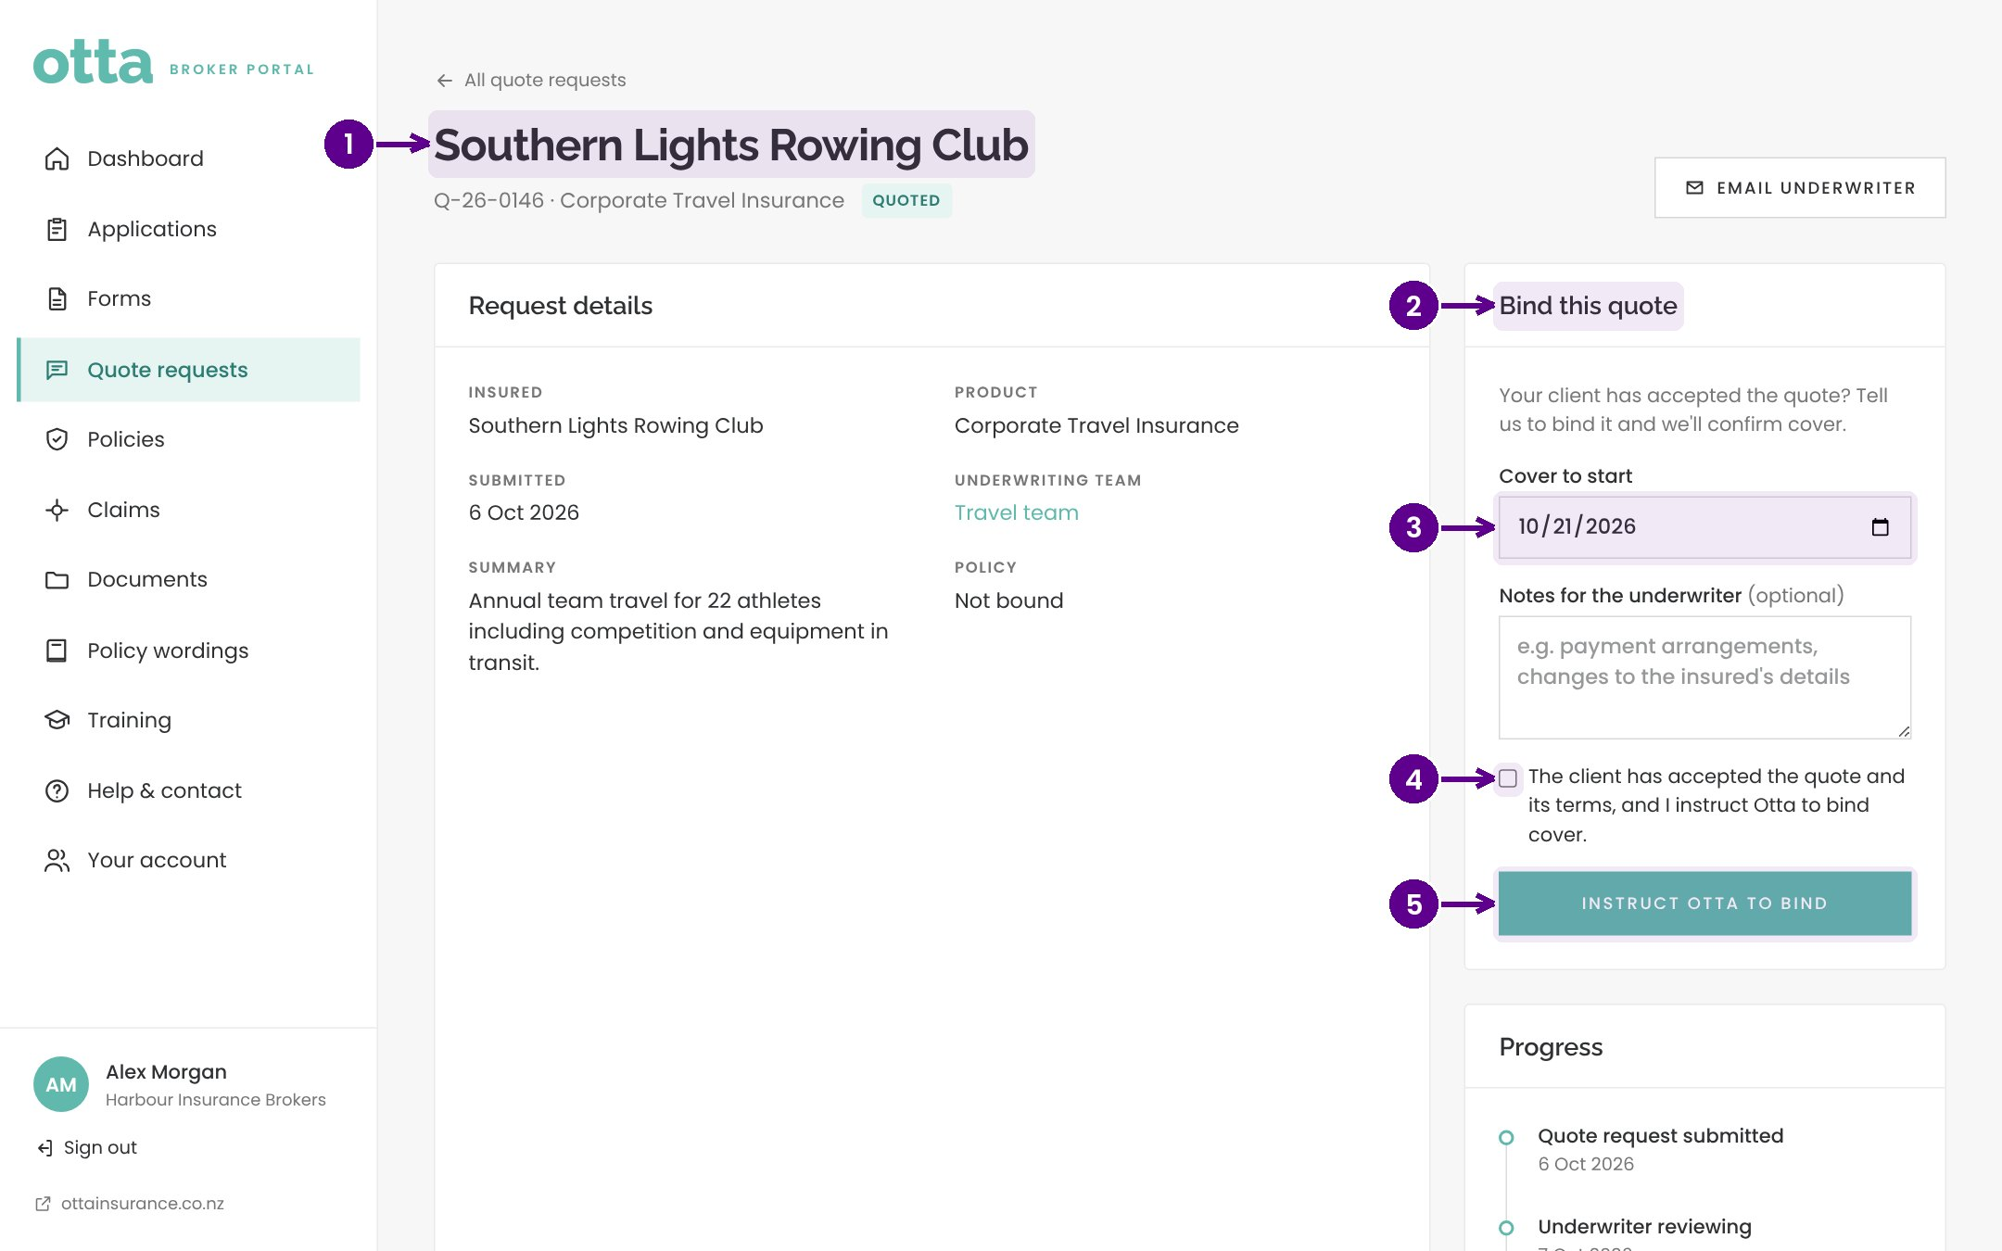
Quote to bind
WHAT YOU'LL SEE
The broker opens the quote
Chooses the inception date and confirms acceptance
Admin gets a bind instruction, with confetti
WOW MOMENT
No more "please bind" emails lost in an inbox.
Notes:
Bind quote Q-26-0146 as Alex. The instruction, date and confirmation are captured in one step.

Slide 11
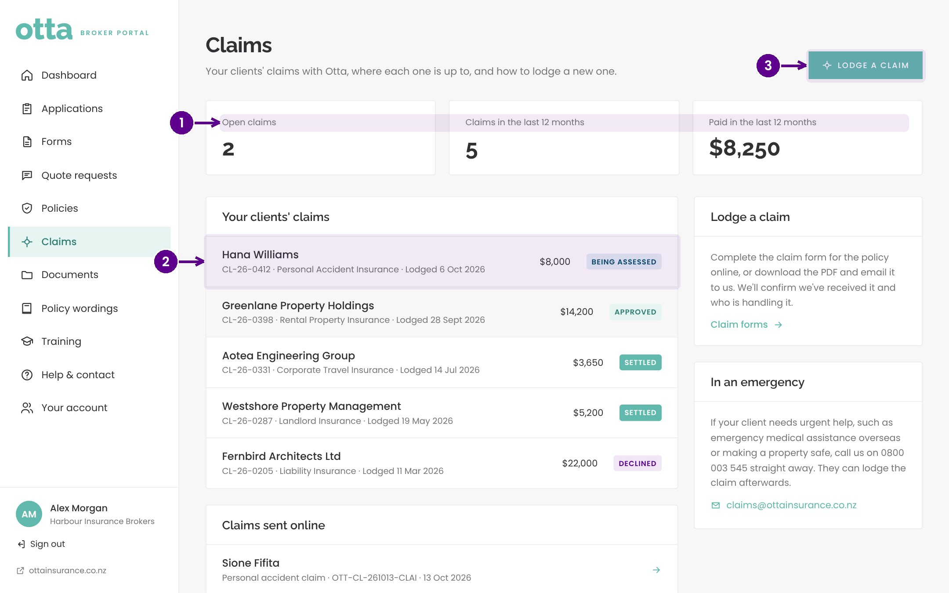
Claims, wordings and training
WHAT YOU'LL SEE
Open claims, what has been paid, and each claim's progress
Every policy wording in one place
A training walkthrough for every new broker
WOW MOMENT
Fewer "where's my claim at?" calls, because brokers can see it.
Notes:
Brokers follow their clients' claims themselves, find wordings without asking, and learn the portal from the Training page their welcome email links to.

Slide 12
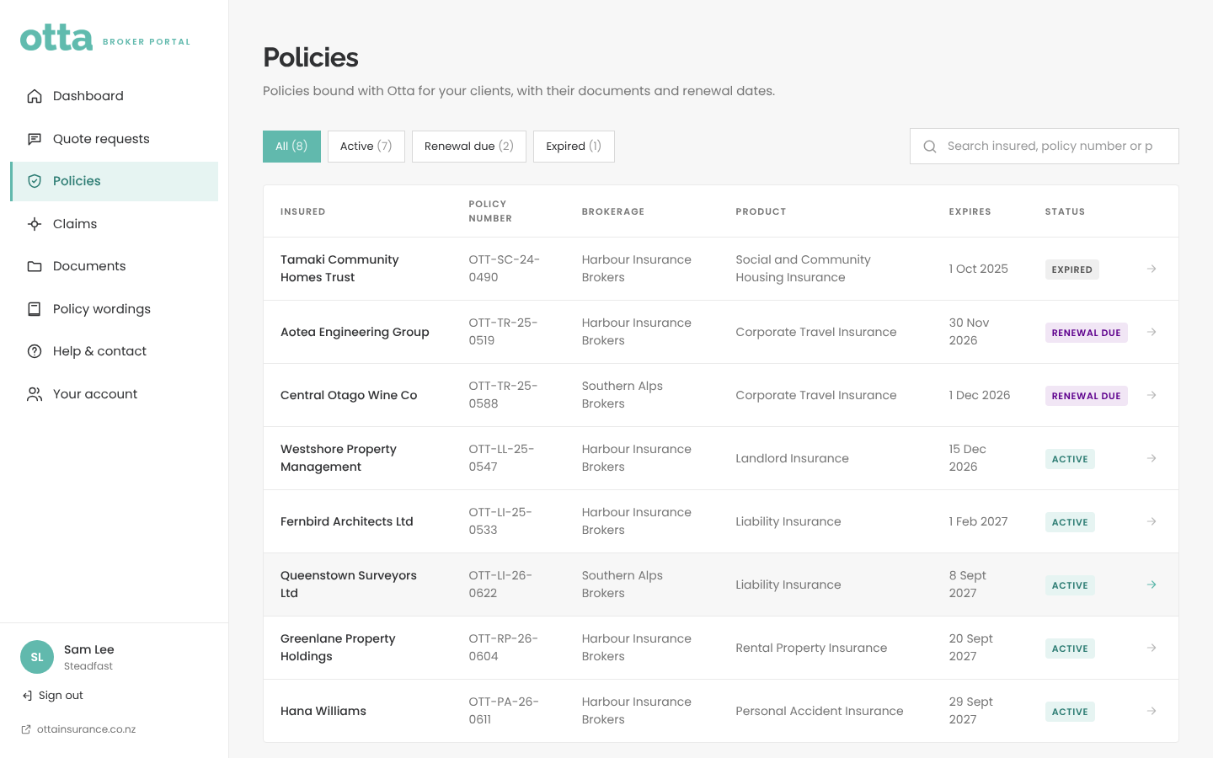
Who sees what
WHAT YOU'LL SEE
Individual broker, broker company, network, coverholder
Beazley sees only property, across every broker
Otta sets the level quietly from admin
WOW MOMENT
Beazley and Canopius see their own book in real time, with no reports to build.
Notes:
Sign in as Beazley in a private window, then Steadfast. Nobody is told their level. Networks and coverholders are view only.

Slide 13
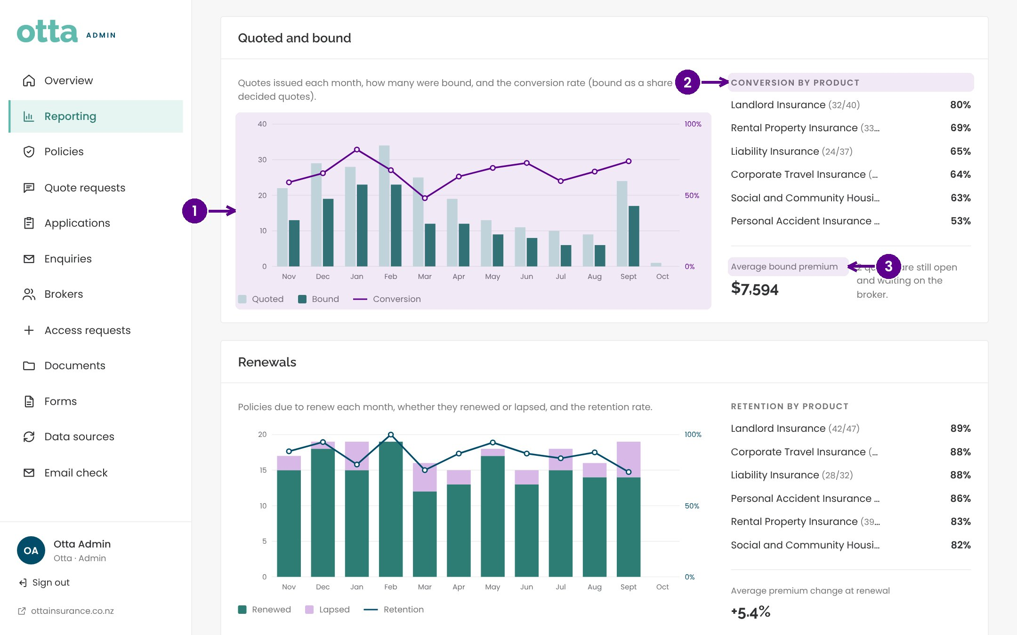
Reporting
WHAT YOU'LL SEE
Premium in force by product and brokerage
Quoted to bound conversion by month and product
Renewal retention and renewals coming up
WOW MOMENT
The board pack builds itself.
Notes:
Before this month the figures are sample history; they turn real once InsuredHQ is connected. Filter by Beazley's products to show the coverholder view.

Slide 14
New this week
02
Three ideas from the board, already built: e-signatures, document uploads, and website analytics and SEO.
Notes:
New this week. Three ideas from the board, already built: e-signatures, document uploads, and website analytics and SEO.

Slide 15
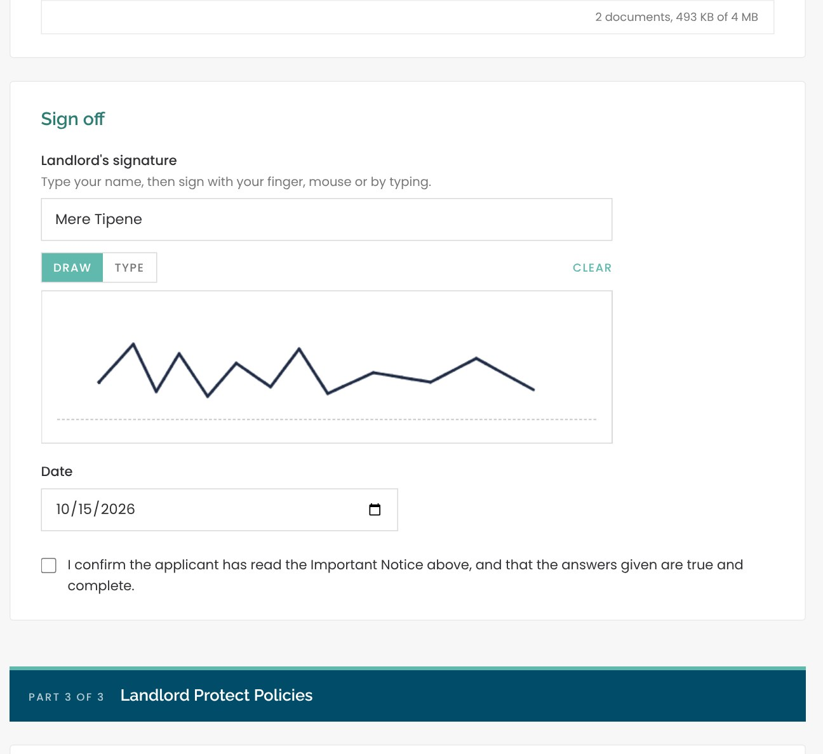
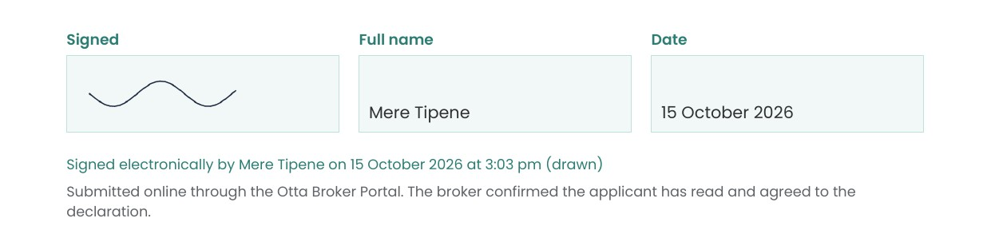
E-signatures on every online form
Sign with a finger, pen or mouse, or type a name in a handwriting style
Works for brokers in the portal and for clients completing a broker's link
Stamped with the time the form was submitted
Shown in the admin and broker portals, and in the PDF
IN THE PDF
Notes:
No more printing, signing and scanning the declaration. The signature goes into the PDF with a note: signed electronically by the name, on the date and time, drawn or typed. For signatures with legal weight on high value policies we could add a verified service later; this covers the everyday declaration.

Slide 16
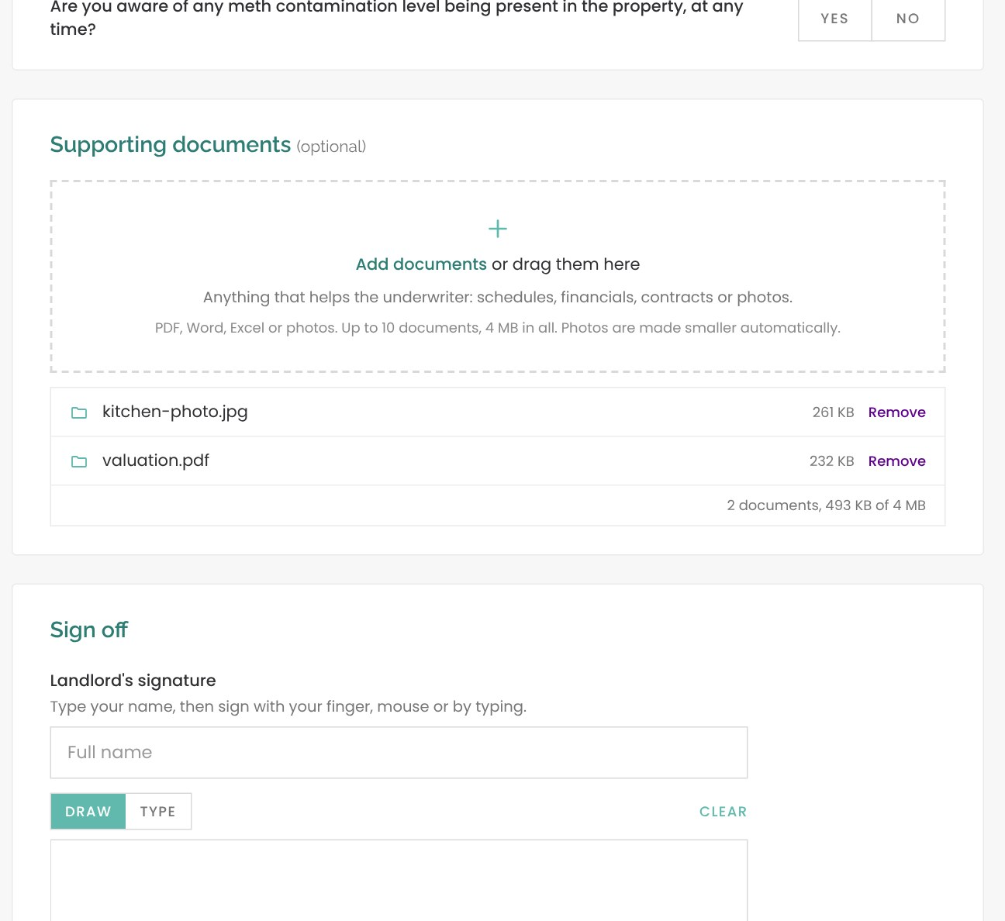
Supporting documents with the application
Valuations, photos, inspection reports, receipts: drag them in or tap to add
PDF, Word, Excel or photos, up to 10 documents
Photos are made smaller automatically, so more fit
Attached to the email to the Otta team, with the application PDF
Open from the application in the admin portal and the broker's portal
Claim forms ask for receipts and reports; proposals for valuations and photos
Notes:
The underwriter gets everything in one place on day one, instead of chasing attachments by email. There's a 4 MB limit per form today; larger files would move to file storage in Phase 2.

Slide 17
Website analytics and SEO
www.ottainsurance.co.nz › solutions › rental-property-insurance
FOUND ON GOOGLE
Rental Property Insurance NZ, including meth and tenant damage | Otta
Titles and descriptions written for niche searches
Sitemap, structured data and share images
Portals and client links never indexed
Rental property insurance for New Zealand landlords, with cover for intentional damage by tenants and methamphetamine contamination. Backed by Lloyd's of London, arranged through your broker.
ANALYTICS
How Otta will look in Google for each product
Visitors, where they came from, which products they view
No cookies needed; Google Analytics optional
Switches on at launch with the Coming Soon page
Notes:
The site stays hidden from Google while the Coming Soon page is on. On launch day we switch it off and Google can index the website, but never the portals. Analytics shows which products people look at, so marketing knows what's working.

Slide 18
What could we add?
03
Open the demo day page on your phone and vote for the three you'd want most.
Notes:
What could we add?. Open the demo day page on your phone and vote for the three you'd want most.

Slide 19
Ideas board
Done this week
Phase 2 candidates
Phase 3 candidates
✓ E-signatures on proposals
InsuredHQ live sync
Instant indicative quotes
✓ Document uploads with applications
Lloyd's bordereaux export
Commission statements in the portal
✓ Website analytics and SEO
Automatic renewal invitations
Assistant learns from decisions
Online claims for every product
Online premium payments
Quote documents from admin
Simple copy editor
Broker alerts by email or SMS
Case studies and news
Audit trail
Notes:
Three of the sixteen are already built. Ask everyone to vote on the demo day page; the results feed the Phase 2 and 3 plan. The big one is InsuredHQ: it turns reporting, claims and the broker book into live data.

Slide 20
Copy still needed
04
38 pieces of wording before launch. Every one needs a name and a date today.
Notes:
Copy still needed. 38 pieces of wording before launch. Every one needs a name and a date today.

Slide 21
Where the copy gaps are
BLOCKS LAUNCH
Fair Insurance Code statement
Complaints process
Dispute resolution scheme
Cooling off period
FSP number
Policy wording contact details
Chat wording review
Notes:
The compliance wording comes first: the site can't go live without it. The full list, with space to write the copy, is in the Word tracker on OneDrive and on the demo day page, where owners and dates update for everyone.

Slide 22
Getting Phase 1 live
05
Phase 1 is the public website. Leave with an owner and a date on every line.
Notes:
Getting Phase 1 live. Phase 1 is the public website. Leave with an owner and a date on every line.

Slide 23
Three phases
Phase 1, now
Phase 2
Phase 3
Website live
Portals live
Grow
Compliance wording and final copy
Photos, video and licences
Domain, email sending, analytics
Coming Soon page off
InsuredHQ sync and real data
Microsoft and Google sign-in
Real broker emails
Top-voted Phase 2 ideas
Instant indicative quotes
Payments and commission statements
The rest of the ideas board
Notes:
The portals are built and demo ready. They go live once real data and sign-in are connected; that's Phase 2. Phase 1 is only the website, so the list of what's left is short and mostly copy.

Slide 24
Phase 1 go-live checklist
Content
Technical
Decisions
Compliance wording approved
ottainsurance.co.nz pointed at the site
Launch date
FSP number confirmed
Sending domain verified in Brevo
Who signs off compliance
Video and stock photos licensed
Team inboxes confirmed
Chat at launch: Brad, both or none
FAQ answers approved
Demo email redirect off
Account Login: live portal or coming soon
Chat wording reviewed
Privacy policy page live
Handling direct enquiries
Otta story and case studies, or pages hidden
Coming Soon page off, analytics on
Portal and admin addresses
Notes:
Each line has a space for an owner and a date on the demo day page. Go through Decisions together; Content and Technical can be assigned and followed up after the meeting.

Slide 25
Next steps
Owners on every copy item · Launch date agreed · Compliance sign-off booked · Votes in for Phase 2
Notes:
Recap the decisions captured on the demo day page, copy the summary into the follow-up email, and press Celebrate.

